Slide 1



Lost in Translation?
Working towards a shared language between schools and youth work
For Scotland's learners, with Scotland's educators
Do luchd-ionnsachaidh na h-Alba, le luchd-foghlaim Alba
Notes:
The facilitator should introduce the resource, ensuring that participants have read the introduction

Slide 2
Activity 1
Reaching a shared understanding – Whose role is it?
For Scotland's learners, with Scotland's educators
Do luchd-ionnsachaidh na h-Alba, le luchd-foghlaim Alba
Notes:
This first activity takes the form of a quiz. It is designed to share information about the roles and responsibilities of schools and youth work.

Slide 3
Question 1:
Whose role is it to support the development of skills for learning, skills for life and skills for work?
For Scotland's learners, with Scotland's educators
Do luchd-ionnsachaidh na h-Alba, le luchd-foghlaim Alba

Slide 4


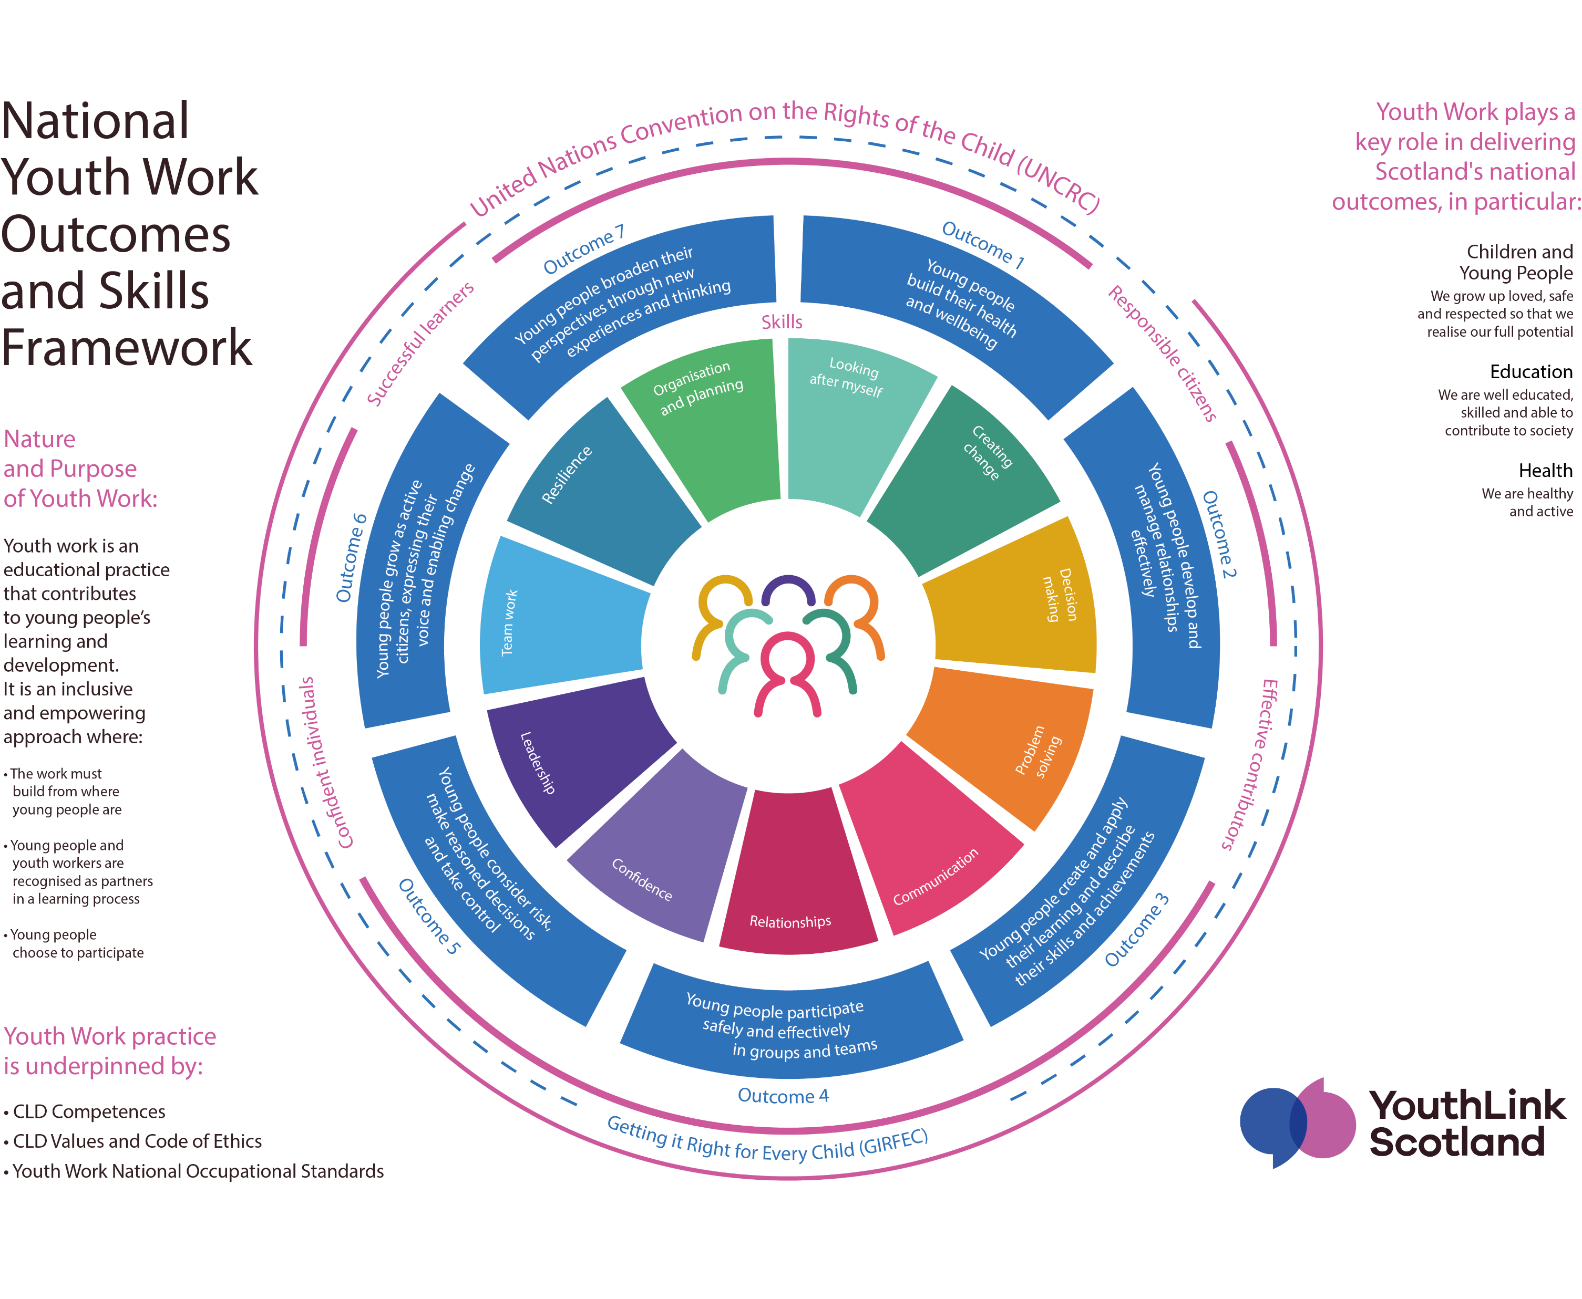

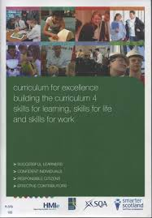
Answer: Both
For Scotland's learners, with Scotland's educators
Do luchd-ionnsachaidh na h-Alba, le luchd-foghlaim Alba
Notes:
Opportunities for developing skills for learning, skills for life and skills for work is one of the Curriculum entitlements.
Building the curriculum 4- skills for learning, skills for life and skills for work outlines the vital role of skills development in supporting young people to become successful learners, confident individuals, responsible citizens and effective contributors. It reaffirms that all children and young people are entitled to opportunities for developing skills for learning, life and work. And that skills should be developed across all curriculum areas, in interdisciplinary studies and in all the contexts and settings where young people are learning. This includes in the community and should include experiential opportunities. They are the responsibility of all adults working with children and young people.
It also highlights that it is important that children and young people are aware of, and understand, the value of the skills that they are developing.
Every child and young person is entitled to support to enable them to gain as much as possible from the opportunities to develop their skills which Curriculum for Excellence can provide.
Partnership working is crucial to the realisation of young people’s entitlement to develop and recognise their skills. BtC4 says “All establishments should work with partners and share a common understanding and language around skills development and application. Together, they should plan and deliver learning and other experiences which meet the needs of individual children and young people.”
Young people develop a range of transferable, core skills through youth work. These skills help them to live, learn and work and reach their full potential. Young people tell us that they value the skills developed through youth work and the experiential opportunities to develop and ‘try out’ their skills. The youth work sector in Scotland has developed a framework for youth workers to support young people to develop, recognise and articulate their skills development. This common language is helping young people understand the value of the skills they are developing, and supports progression.
The National Youth Work Outcomes and Skills Framework articulates the key skills that young people develop through youth work. Youth workers use this to help young people to develop, recognise and articulate their skills and achievements. They use the tool within approaches such as reflective learner conversations. The Framework shows young people how their progress through youth work contributes to the development of the four capacities of curriculum for excellence and the My World of Work meta skills. The Framework offers a common language – of skills – for those working with young people. This can support joint planning and evaluation, including understanding the impact of youth work interventions on attendance, engagement and achievement.

Slide 5
Question 2:
Whose role is it to engage with families and communities?
For Scotland's learners, with Scotland's educators
Do luchd-ionnsachaidh na h-Alba, le luchd-foghlaim Alba

Slide 6
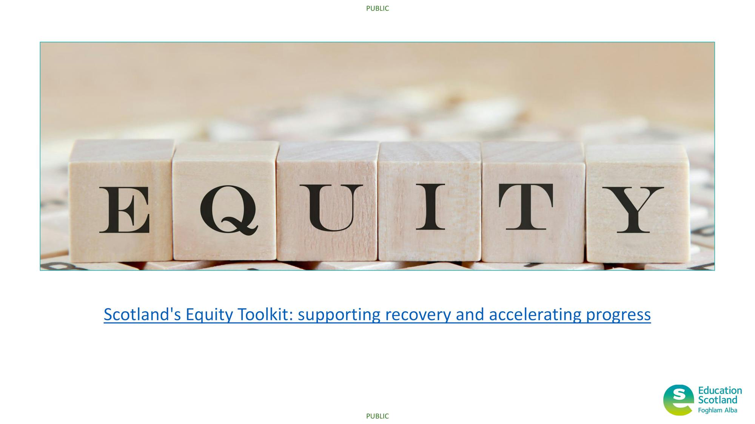
Answer: Both
For Scotland's learners, with Scotland's educators
Do luchd-ionnsachaidh na h-Alba, le luchd-foghlaim Alba
Notes:
Scottish Government guidance to support the SAC emphasizes the need to engage with learners, families and the wider community. This includes working collaboratively with partners such as youth work. Youth workers engage with young people in the context of their family and community and often have relationships with and knowledge of the young person’s circumstances and context that can support parental engagement, family learning, engagement and attendance in school. Youth work and school partnerships can provide a bridge between school and home/community, ensuring young people have access to a broad range of experiences and are able to recognise and value their contribution to their learner journey.
Scotland’s Equity Toolkit: supporting recovery and accelerating progress is an accessible, live resource that has been shaped by practitioners to support the refreshed mission of the Scottish Attainment Challenge with a particular focus on closing the poverty-related attainment gap. Information and links in one place signposting practitioners to what can be done and the conditions required for success throughout the learner journey. Material that can be used and adapted in a range of settings to ensure every child and young person has the same opportunity to succeed. It can be used by a range of stakeholders involved in improving outcomes for children and young who are most impacted by poverty such as practitioners, school leaders, youth workers and LA staff.

Slide 7
Question 3:
Whose role is it to deliver Curriculum for Excellence?
For Scotland's learners, with Scotland's educators
Do luchd-ionnsachaidh na h-Alba, le luchd-foghlaim Alba

Slide 8
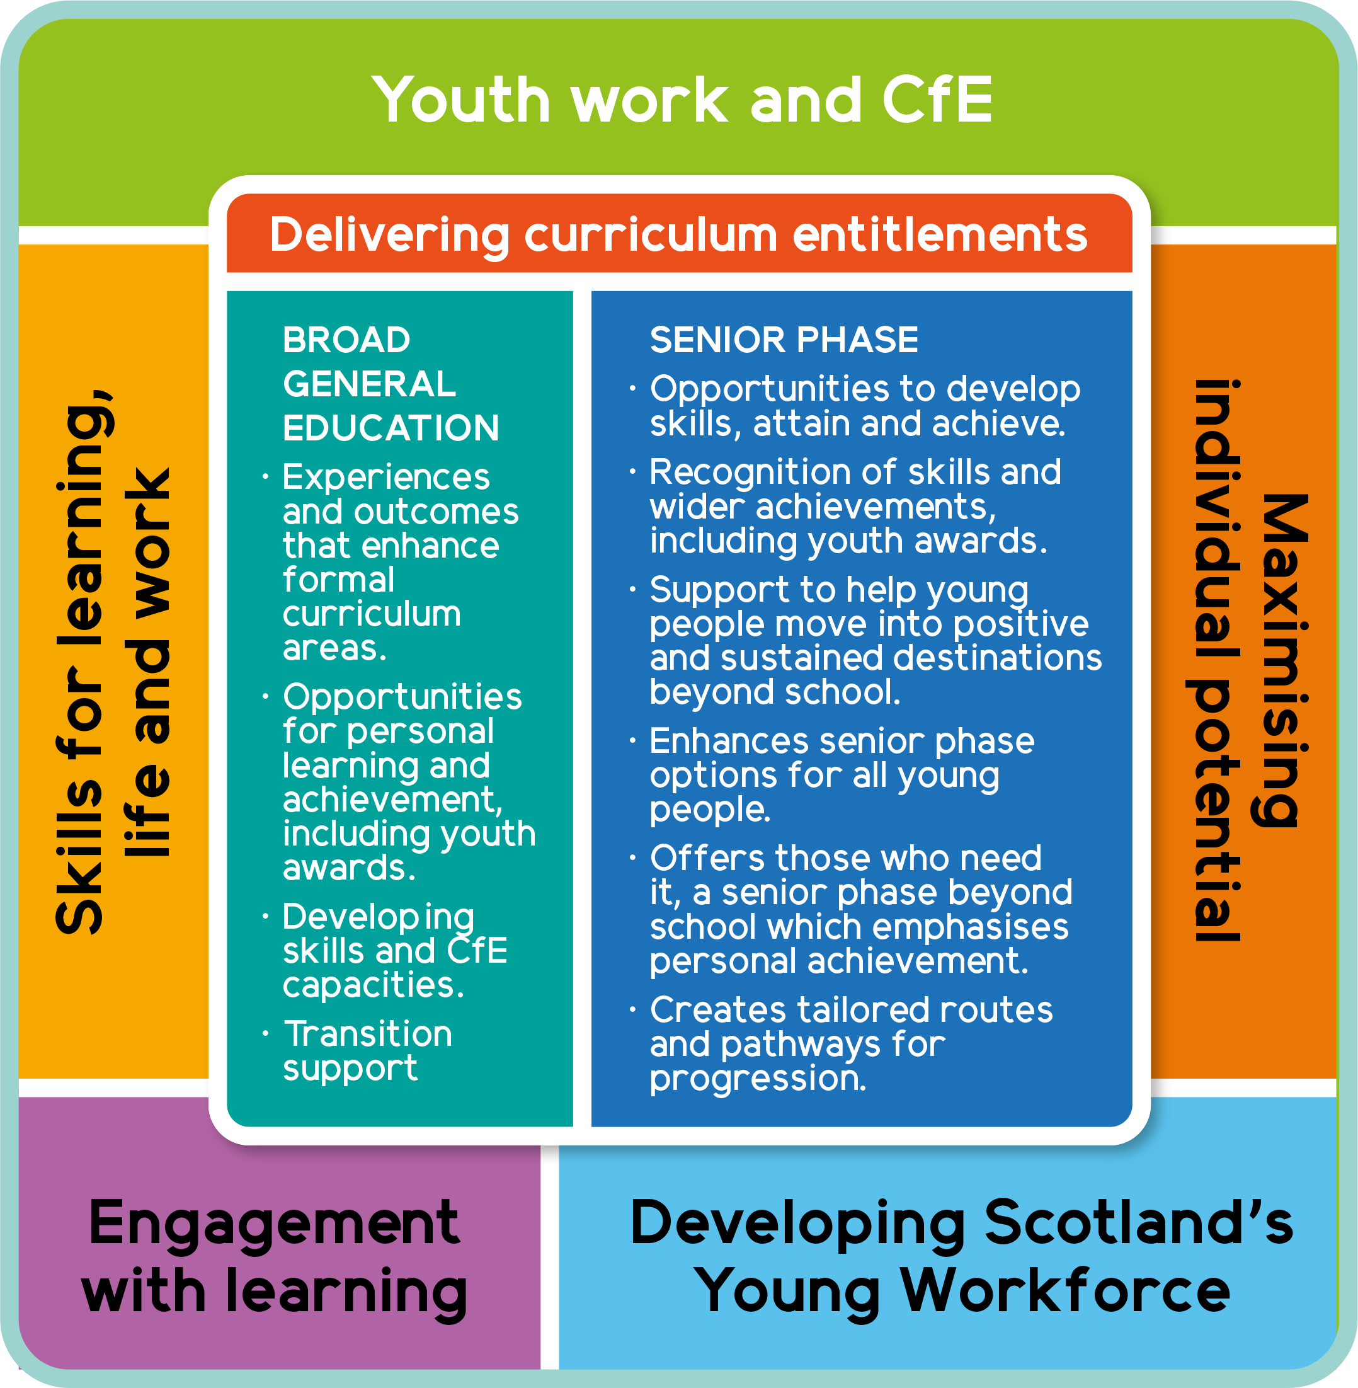
Answer: Both
“The curriculum is more than curriculum areas and subjects. It is the totality of experiences which are planned for children and young people through their education ”
Building the Curriculum 4
For Scotland's learners, with Scotland's educators
Do luchd-ionnsachaidh na h-Alba, le luchd-foghlaim Alba
Notes:
There are a range of partners involved in the delivery and oversight of Curriculum for Excellence, including Community Learning and Development. Alongside education, youth work delivers curriculum entitlements across the Broad General Education and Senior Phase to provide opportunities for children and young people to attain and achieve, including to study for qualifications, awards and other planned activities to develop the four fundamental capacities:
Successful learners
Confident individuals
Responsible citizens
Effective contributors
“Curriculum is defined as the totality of all that is planned for children and young people from early learning and childcare, through school and beyond. That totality can be planned for and experienced by learners across four contexts” - CfE refreshed narrative
Learners are entitled to experience a BGE across all four contexts (opportunities for personal achievement, interdisciplinary learning, ethos and life of the school as a community and curriculum areas and subjects). In particular, youth work delivers opportunities for personal learning and achievement in schools and the community.
For some young people, youth work is the key to unlocking learning, overcoming barriers to engagement and providing a more tailored curriculum offer.
Since the launch of the Scottish Attainment Challenge in 2015 and the introduction of Pupil Equity Funding in 2016, the role of youth work has been to work in partnership with education to support equity in the planning, delivery and evaluation of interventions to improve outcomes for children and young people affected by poverty. The role of youth work within the attainment challenge offers real-life resources and expertise that schools cannot provide in isolation, with successful partnerships evidencing improvements for learners through close collaboration and communication between the school and the partner and having a clear impact on the quality of learning experiences band influenced young people's positive learning attributes. Involving youth work in the design thinking approach to curriculum in school has helped schools to ‘think big’ around the partnership between school and parents.

Slide 9
Question 4:
Whose role is it to support the health and wellbeing of children and young people?
For Scotland's learners, with Scotland's educators
Do luchd-ionnsachaidh na h-Alba, le luchd-foghlaim Alba

Slide 10
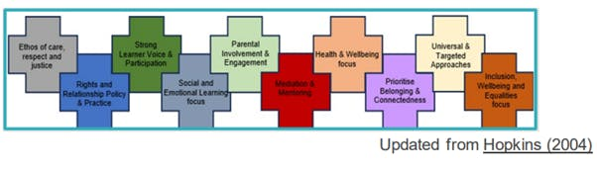
Answer: Both
For Scotland's learners, with Scotland's educators
Do luchd-ionnsachaidh na h-Alba, le luchd-foghlaim Alba
Notes:
Everyone, whatever their contact with children and young people may be, shares the responsibility for creating a positive ethos and climate of respect and trust – one in which everyone can make a positive contribution to the wellbeing of each individual within the school and the wider community. Youth work contributes to delivering the key priorities outlined in the National Improvement Framework, helping to achieve excellence and equity through Improvement in children and young people’s health and wellbeing. Its strong focus on equity and inclusion underpins practice and the sector’s contribution to the national improvement priorities. This includes working towards equity of experience and outcomes for young people with protected characteristics and in recognition of the concept of intersectionality.

Slide 11
Question 5:
Whose role is it to track and monitor the achievements of children and young people?
For Scotland's learners, with Scotland's educators
Do luchd-ionnsachaidh na h-Alba, le luchd-foghlaim Alba

Slide 12




Answer: Both
For Scotland's learners, with Scotland's educators
Do luchd-ionnsachaidh na h-Alba, le luchd-foghlaim Alba
Notes:
The Attainment Scotland Fund provides funding to four national partners: Youthlink Scotland, Child Poverty Action Group, CELCIS and Young Scot to work closely with the Scottish Government and other SAC partners to promote and develop the role of youth work in closing the poverty related attainment gap. This is achieved by sharing good practice, supporting practice development and helping to gather evidence of the impact of youth work on attainment and improved outcomes across a learners journey through education.
The Youth Work National Operational Standards articulates the role of a youth worker, including enabling young people to identify, reflect on and use their learning to enhance their future development. Youth workers work together with young people to track and monitor their achievements, such as using the National Youth Work Outcomes and Skills Framework to supporting learner conversations and profiling. Many youth workers also work with youth awards providers to recognise achievements through youth awards.

Slide 13
Question 6:
Whose role is it to raise attainment?
For Scotland's learners, with Scotland's educators
Do luchd-ionnsachaidh na h-Alba, le luchd-foghlaim Alba

Slide 14
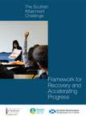
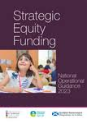

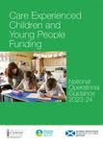
Answer: Both
For Scotland's learners, with Scotland's educators
Do luchd-ionnsachaidh na h-Alba, le luchd-foghlaim Alba
Notes:
Over the last 8 years a suite of guidance documents have been developed to reflect the needs, evolution and diversity of the funding strands. The Attainment Scotland Fund has 3 key strands, which are the Pupil Equity Fund, where £130 million is distributed annually on an allocation of £1025 per head to 97% of schools for pupils in P1-S3 known to be eligible for free school meals. The care experienced fund is provided to local authorities to enable targeting of initiatives, activities, and resources that will improve the educational outcomes of children and young people who have experienced care, contributing to keeping The Promise. This is directed by Chief Social Work and Education Officers, in conjunction with key planning partners to target how its invested. The funding is intended to be inclusive, with care experienced children and young people from birth to the age of 26, being eligible for the fund. Each local authority receives £1,225 per looked after child aged 5 to15 as reported in the Children's Social Work Statistics Scotland publication. In 2022 there was a refresh of the Scottish Attainment Challenge and as part of this, the distribution of funds was calculated more equitably with all 32 local authorities receiving a share of £43 million annually of Strategic Equity Funding and having a clear role to play to invest in approaches to achieving the mission of the Scottish Attainment Challenge. This replaced the previous model of local authority groupings considered ‘Challenge, Schools or Universal’ authorities, where there were significant differences in the levels of funding provided and their experience of tackling the PRAG. Governance of the Strategic Equity Fund is monitored through The Framework for recovery and accelerating progress, which was developed as part of the refreshed mission in 2022. This document:
reinforces the collective commitment to equity in education
reiterates the respective roles and responsibilities for improvement across the education system
encourages partnership working and collaboration at all levels of the education system and with local and third sector partners
sets high expectations for progress in closing the poverty related attainment gap
requires local authorities to set stretch aims for progress in closing the poverty related attainment gap by 2025/26, which reinforces accountability, whilst encouraging empowerment for how the challenge is delivered locally and what progress looks like in each area.

Slide 15
Question 7:
Whose role is it to tackle the poverty related attainment gap?
For Scotland's learners, with Scotland's educators
Do luchd-ionnsachaidh na h-Alba, le luchd-foghlaim Alba

Slide 16
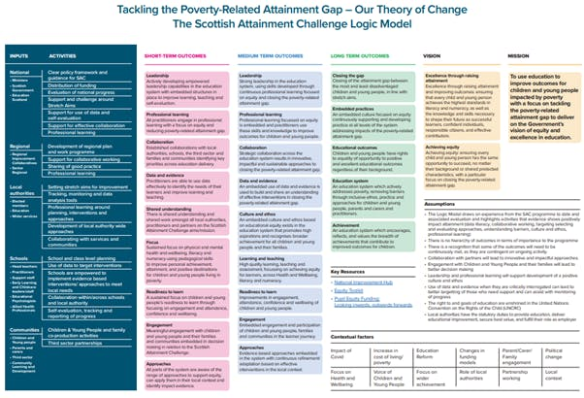
Answer: Both
For Scotland's learners, with Scotland's educators
Do luchd-ionnsachaidh na h-Alba, le luchd-foghlaim Alba
Notes:
The Scottish Attainment Challenge Logic Model illustrates, at a high level, the activities that will lead to the short, medium and long term outcomes designed to achieve the Scottish Attainment Challenge mission ‘to use education to improve outcomes for children and young people impacted by poverty, with a focus on tackling the poverty-related attainment gap’. The Logic Model seeks to balance the complexity of the SAC Mission and the simplicity of a useable tool which is accessible and meaningful to all stakeholders and activities they may carry out in different, and interrelated ways. The framework for recovery also highlights the SAC logic model as a key resource to help inform approaches to accelerating progress. There are 4 logic models to illustrate the varying activities from the national strategic level to the operational school and local level:
Overall logic model – summarising all inputs and activities
National logic model – for central government, national bodies
Regional/local logic model – for Regional Improvement Collaboratives, Local Authority Scottish Attainment Challenge leads
School/community logic model – for school leaders, practitioners, children and young people, parents, carers, families, community organisations, third sector
The logic models can be used locally in a number of ways to support progress towards the Scottish Attainment Challenge mission and as a systematic tool to drive improvement in a school or locality; there is no one-size fits all approach. For note, schools and local authorities are not expected to formally report against progress towards the logic model outcomes, but discussions around this would form part of the usual dialogue with Education Scotland Regional Improvement Teams, including Attainment Advisors. The model is one of a range of tools which schools can use to support planning and monitoring of progress in closing the poverty-related attainment gap. For example, it can be used alongside school self-evaluation to inform discussions about progress and next steps
Guidance to support the SAC emphasises the need for a collaborative approach to closing the poverty-related attainment gap. The role of youth work is supported through one of the SAC national programmes, delivered by YouthLink Scotland. More information about the role of youth work in the SAC can be found on their website https://www.youthlink.scot/education-skills/scottish-attainment-challenge/ and in the Guide for Schools publication. Youth work and school partnerships are effectively improving school attendance and engagement in learning, raising attainment and achievement. This includes opportunities provided by youth work outwith school – during holiday periods, after school for young people and the wider family.

Slide 17
Question 8:
Whose role is it to assist children and young people to recognise, realise and defend their rights?
For Scotland's learners, with Scotland's educators
Do luchd-ionnsachaidh na h-Alba, le luchd-foghlaim Alba

Slide 18
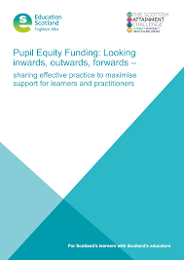
Answer: Both
For Scotland's learners, with Scotland's educators
Do luchd-ionnsachaidh na h-Alba, le luchd-foghlaim Alba
Notes:
On 7 December 2023, the Scottish Parliament unanimously passed the United Nations Convention on the Rights of the Child Bill for the second time. The Bill is a landmark piece of legislation that incorporates the UNCRC into Scots law and it is clear that we all have a duty to ensure that we assist children and young people to recognise, realise and defend their rights.
All local authorities should promote the meaningful involvement of staff, parents and pupils in PEF, as outlined in Article 12 of the UNCRC. As described in the PEF inwards outwards forwards document, the value of consultation as part of PEF planning is recognised and encouraged by local authorities. For example Stirling Council developed a ‘Social Justice Ambassadors’ programme to ensure the meaningful involvement of children and young people in decision making which affects them, including PEF. Most commonly this was through consultations with Pupil Councils and Parent Councils. However, there were a few examples of wider consultation, including examples of Participatory Budgeting.
Youth work is human rights work. The sector’s rights-based approach spans young people’s lives from non-discrimination, to meaningful participation, health, education, and play. In doing so, youth work has an integral role in realising national ambitions to make Scotland the best place to grow up.
The UN Convention on the Rights of the Child wraps around the Youth Work Outcomes and Skills Framework, cementing youth work as a rights-respecting and rights-promoting practice.
We believe young people have a right to access youth work. It shouldn’t be a postcode lottery whether you are able to access quality youth work. Incorporation of UN Convention on the Rights of the Child into Scots law gives an opportunity to rectify this.
Youth work and school partnerships are providing opportunities such as youth voice and participation, including opportunities for social action.

Slide 19
Question 9:
Whose role is it to engage with children and young people who choose to participate in community activities?
For Scotland's learners, with Scotland's educators
Do luchd-ionnsachaidh na h-Alba, le luchd-foghlaim Alba

Slide 20

Answer: Youth work
For Scotland's learners, with Scotland's educators
Do luchd-ionnsachaidh na h-Alba, le luchd-foghlaim Alba
Notes:
The nature and purpose of youth work in Scotland sets out the distinct and key features of the practice, including the voluntary nature of young people’s participation.
Youth work may involve activities and opportunity for social interaction. Activities are often used as engagement tools, or to create opportunity to develop skills. The focus is on the learning and development of young people, with the relationship between youth worker and young person playing a key role. This resource on screen sets out how purposeful partnerships with appropriate third sector organisations, including youth work can improve outcomes for children, young people and families. The third sector has experience in delivering projects which address each of the three priorities identified for the Scottish Attainment Challenge but is particularly well placed to support improvements to health and wellbeing and to improve employability skills and school leaver destinations. One of the primary levers for change is recognised as being partnership work with families and communities and it is here that participation in community activities can be of particular value.

Slide 21
Question 10:
Whose role is it to report to parents/carers about the progress of children and young people?
For Scotland's learners, with Scotland's educators
Do luchd-ionnsachaidh na h-Alba, le luchd-foghlaim Alba

Slide 22
Answer: School
For Scotland's learners, with Scotland's educators
Do luchd-ionnsachaidh na h-Alba, le luchd-foghlaim Alba
Notes:
The National Improvement Framework highlights the importance of engaging learners and parents/carers effectively in approaches to reporting. Crucially, it emphasises the value of ensuring parents/carers are supported to enable them to play an active role in their children’s learning and achievement. Therefore, parents and families must have access to information that allows them to form a clear understanding of how their child is progressing, and the information they need to help them play a key role in their child’s education.
Youth workers support children and young people to reflect on their progress and may, as appropriate, work with them to inform parents/carers about progress. The difference here is that there is not a duty to ‘report’.

Slide 23
Challenge Questions
Did any of the roles and responsibilities surprise you? Why?
How did it feel to acknowledge areas of shared responsibility?
What impact might this have on your practice?

Slide 24
Links
Building the Curriculum 4 Skills for learning, skills for life and skills for work
UN Convention on the Rights of the Child UNCRC
Youth Work: a Guide for Schools
National Youth Work Outcomes and Skills
Scotland’s Equity Toolkit
For Scotland's learners, with Scotland's educators
Do luchd-ionnsachaidh na h-Alba, le luchd-foghlaim Alba
Notes:
This is an internal page in blue and can be duplicated to create additional pages. Always keep the heading and footer as shown. Use the corresponding blue internal and back pages if you are using this page.

Slide 25
Activity 2
Myth Busting!
Youth work can help improve school attendance
Youth awards are only valuable to schools if they attract Insight tariff points.
Community planning is for CLD and does not involve schools.
Pupil Equity Funding can’t be used for interventions that take place out-with term-time or for community-based interventions.
Youth work is about playing table tennis and hanging about with your pals.
The National Youth Work outcomes have nothing to do with Curriculum for Excellence.
For Scotland's learners, with Scotland's educators
Do luchd-ionnsachaidh na h-Alba, le luchd-foghlaim Alba
Notes:
Facilitator to break participants into smaller groups to undertake this exercise
Facilitator’s notes:
1. Facilitators to invite participants to reflect on what they’ve heard so far about the roles of youth work and schools. Any surprises about what they’ve heard? What misconceptions exist about schools or youth work?
2. Each discussion group is given the statements on the slide to discuss. Facilitators should encourage participants to acknowledge that what is obvious to one person, may not be to another. This is because we all bring different knowledge, experiences and perspectives to the table. Be empathic and willing to learn from each other.

Slide 26
Challenge Questions
How did the different knowledge, experience and perspectives of your group help to develop a shared understanding?
How can a better understanding help us work towards a common language to plan, track progress/achievement and measure improvement together?
What opportunities are there to find a shared language?
Notes:
Facilitator may wish to bring the group back together to feed back and explore the challenge questions
Highlight the glossary of terms document (Sharing terminology between practitioners)

Slide 27
Learning from Practice
For Scotland's learners, with Scotland's educators
Do luchd-ionnsachaidh na h-Alba, le luchd-foghlaim Alba
Notes:
LEARNING FROM PRACTICE
It may be helpful to provide opportunity for participants to engage with some of the practice sharing examples as part of the session.
The case studies illustrate where a shared understanding and a common professional language have supported the development of relationships based on mutual respect and improved the partnership working
The case study on the next slide is from Highland

Slide 28
The Ullapool Late Bus – example of innovative practice
Enabling access to activities offered in school and the community beyond the school day.
To address equity - increase engagement from young people, from remote areas furthest from the school to access after school activities
Effective partnership working resulted in a successful bid to the Highland Cares Fund for a bus driver. This has enabled (x%) of young people to participate in clubs or use of the Youth Space in the village to socialise beyond the school day. The bus is available, free of charge, on Mondays and Wednesdays. The councillor liaised with the LA to overcome challenges in relation to recruitment and transport contracts.
Notes:
Ullapool High School is in Highland Council, situated in the village of Ullapool, at the seaward end of Lochbroom in Wester Ross. The school serves a delineated catchment area covering a large remote area. The majority of pupils live in SIMD quintiles three and four and less than 10% are entitled to free school meals, however families face challenges due to in-work poverty, fuel poverty and added costs associated with the remote rural location.
A need to support young people to access school and community based activities beyond the school day was identified jointly by the headteacher (HT), youth development worker (YDO) and a local councillor. Analysis identified that a barrier for 2/3 of the school roll was transport home, with 50% living in remote rural areas. A pupil survey by the LA stated 59% of respondents identified lack of transport as a barrier to participation.
What are the features of effective partnership working between UHS and HLH?1 response
Shared values of inclusion and nurture; open, honest, frequent communication (aided by having a shared space). Pupils have easy access to YDO and vice versa. Understanding of each others roles.
How was the partnership developed?1 response
Over time - YDO has been in the school since it opened in 2000. Close working relationships between YDO and office staff, Guidance and SLT. Being able to "pop in" and have a quick chat/run through possible ideas rather than always setting up a formal meeting has been really important. Continuity of staff has also helped build relationships.
Please provide some examples of how collaboration has led to improved outcomes for young people1 response
YDO delivering aspects of PSE e.g Resilience for Life; Youth Achievement Awards/Saltire/Leadership Awards; Late Bus (wellbeing and attainment support), Safe Space (YDO office); P7 transition events, support with school trips, Youth Forum, 'My Future, My Success' Mentoring programme, YDO part of Child Planning and 16+ transition meetings.
What are your top tips for others developing effective partnership working between youth work and school?
Taking time to develop positive relationships; regular face-to-face communication and shared values.

Slide 29
Challenge Questions
Is there anything we might do differently, as a result of this conversation?
What opportunities are there in your context to continue to develop a shared language?
How might this support joint planning, tracking achievement and measuring improvement?
In what ways could you continue to strengthen your school and youth work partnership?
What support do you need?
Notes:
Support is available from YouthLink Scotland Marielle Curran mcurran@youthlink.scot or your Attainment Advisor

